Slide 1
React Q&A
A compilation of React’s FAQs

Slide 2
FAQs of React

Slide 3
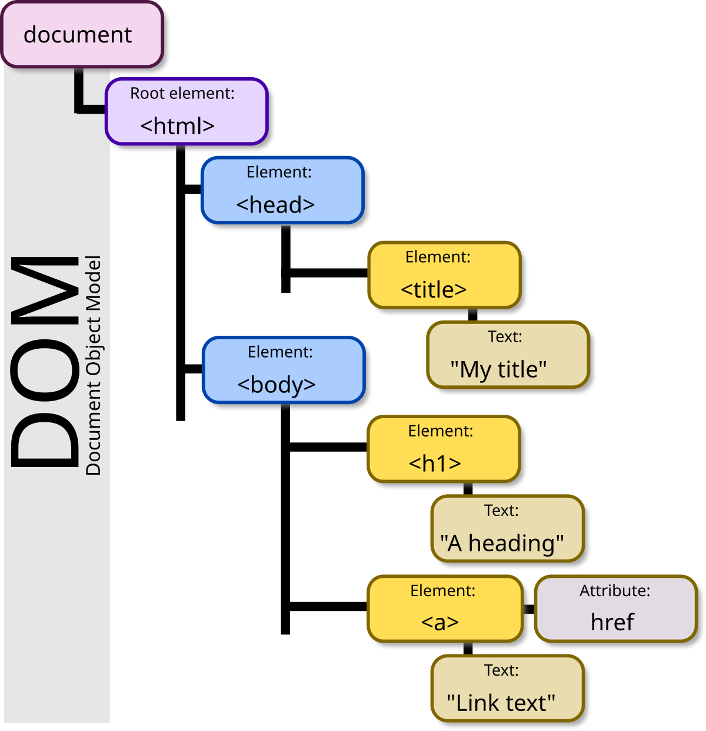
FAQs of React
What is DOM (Document Object Model)?
Document Object Model (DOM) is a way for web pages (HTML and XML) to be represented as a tree-like structure, allowing programming languages like JavaScript to access and manipulate the elements on a page, changing its structure, content, and style.

Slide 4

FAQs of React
What is JavaScript and its various libraries?
JavaScript is a high-level, dynamic, and interpreted programming language that is widely used for adding interactivity and complexity to web pages.
Developed in the mid-1990s by Brendan Eich at Netscape, JavaScript has become an essential part of web development, often referred to as the "language of the web" due to its role in client-side scripting. It can also be used server-side with environments like Node.js.

Slide 5
FAQs of React
What are a Traditional Web Applications?
Traditional web applications (often referred to as multi-page applications, or MPAs) are web-based applications that operate by loading different web pages for different user interactions.
These applications typically utilize server-side rendering (SSR) to deliver their content and are structured to include multiple interconnected web pages, each accessed through a unique URL.
Key Traits:
Multiple HTML Pages.
Server-Side Rendering.
Full Page Reloads.
Statelessness and Session Management.

Slide 6
Traditional Web Applications Vs SPA
Feature | Traditional Web Apps (MPAs) | Single Page Applications (SPAs)
Architecture | Traditional web applications consist of multiple pages that are loaded from the server. Each significant interaction usually leads to a full page reload. | Single page applications operate by loading a single HTML page that updates dynamically as users interact, without reloading the entire page.
User Experience | In traditional web applications, navigating to different pages results in full page reloads, which can disrupt the user experience. Each page has its own URL, which can help with direct linking. | Single page applications provide seamless and fluid interactions, allowing users to navigate through the app without full page reloads, enhancing the overall experience.
Performance | Traditional web applications often place a heavier load on the server because each page request requires a new HTML document to be generated and delivered. | Single page applications initially have a higher load at the start, but they enhance the perceived performance as subsequent interactions typically require less data transfer and can retrieve content asynchronously.

Slide 7
Traditional Web Applications Vs SPA
Feature | Traditional Web Apps (MPAs) | Single Page Applications (SPAs)
Development | Developing traditional web applications can be simpler, especially for small-scale projects where straightforward server-side technologies can be used. | Single page applications require a more extensive knowledge of JavaScript and frameworks, which can introduce complexity to the development process.
Caching | In traditional web applications, each page often has to be fully fetched from the server, which may slow down the user experience. | Single page applications can implement effective caching strategies for API responses, significantly enhancing performance for frequent interactions.
Use Cases | Traditional web applications are well-suited for content-heavy sites, such as blogs or news websites, where easy navigation and SEO are important. | Single page applications are ideal for dynamic applications that require high interactivity, such as social networks, dashboards, and complex web applications.

Slide 8
FAQs of React
What is a Single Page Application?
A Single Page Application (SPA) is a type of web application that interacts with the user by dynamically rewriting the current page rather than loading entire new pages from the server.
SPAs use JavaScript to create a more fluid and responsive user experience by only updating the necessary parts of the webpage rather than reloading the whole page with each user interaction.
This approach helps to mimic the behavior of a desktop application, making the user experience faster and more intuitive.
Key Traits:
Dynamic Content Updates.
Client-Side Rendering.
Single URL.
Improved User Experience.

Slide 9



FAQs of React
Who invented and supported ReatJS?
ReactJS was developed by Jordan Walke, a software engineer at Facebook, in 2011.
Initially, React was created to address the challenges that Facebook faced when developing its user interface, mainly concerning performance and the complexity of state management in large web applications.

Slide 10
FAQs of React
What are the features ReactJS?
ReactJS is a popular JavaScript library for building user interfaces, especially single-page applications, due to its efficient and flexible nature. Here are some of the key features of ReactJS that contribute to its popularity in web development:
Component-Based Architecture - build encapsulated components.
JSX (JavaScript XML) - write HTML-like syntax directly within JavaScript code.
Virtual DOM - React first updates the virtual DOM, then compares it with the real DOM.
One-Way Data Binding - one-way data flow, from parent components to child components.
State Management - built-in features for managing component state.
Declarative UI - developers can describe what the UI should look like for a given state.
Strong Community and Ecosystem.
SEO-Friendly.

Slide 11





FAQs of React
What are the Prerequisites to learn React?
The key prerequisites to effectively learn ReactJS:
HTML/CSS.
JavaScript Fundamentals.
Understanding the DOM.
Basic Git and Version Control.
Basic Command Line Usage.
Familiarity with NPM/Yarn.
JavaScript Promises and Async/Await.
Basic Understanding of APIs and JSON.

Slide 12
FAQs of React
Why we use ReactJS?
ReactJS is widely adopted for building user interfaces, particularly for single-page applications, due to a variety of compelling reasons. Here are some of the main reasons why developers choose to use ReactJS:
Component-Based Architecture.
React Hooks.
Virtual DOM.
One-Way Data Binding.
State Management.
Declarative UI.
Strong Community and Ecosystem.
SEO-Friendly.
Cross-Platform Development.
Backward Compatibility.

Slide 13
FAQs of React
Why invented and supports ReatJS?
ReactJS was invented by Jordan Walke, a software engineer at Facebook, in 2011.
Reasons for Invention:
Performance Issues, Modularity, Simplified Development, Handling Rich Interactions, Reusable Components.
Support for ReactJS:
Facebook continues to be the primary supporter and maintainer of React. The library has evolved significantly since its release, and various teams within Facebook contribute to its development, ensuring continuous improvement and updates.

Slide 14
FAQs of React
Why is the component-based architecture crucial in ReactJS?
The component-based architecture in ReactJS is crucial for several reasons, offering numerous benefits that enhance the development process, maintainability, and performance of web applications. Here are some key points highlighting its importance:
Modularity and Re-usability.
Separation of Concerns.
Easier Maintenance and Updates.
Improved Readability and Organization.
State Management.
Testing and Debugging.
Declarative Coding for every component individually.
Life-cycle Management.

Slide 15
FAQs of React
Why does React use a Virtual DOM instead of directly manipulating the real DOM?
React uses a Virtual DOM (VDOM) as a key performance optimization technique to improve the efficiency of updates and rendering in web applications. Here are the primary reasons for using the Virtual DOM instead of directly manipulating the actual DOM:
Performance Optimization: Batch Updates, Fewer Repaints and Reflows.
Efficient Diffing Algorithm: React employs a diffing algorithm to compare the current Virtual DOM with a previous version. By identifying which components have changed, React can efficiently update only the parts of the real DOM that need to change, rather than re-rendering the entire UI.
Consistency and Predictability.
Improved User Experience.
Simplified State Management.
Cross-Platform Compatibility.

Slide 16

FAQs of React
What-if it is not ReactJS?
If it is not ReactJS, the choice of a different framework, library, or approach for building user interfaces will have various implications depending on the specific technology being considered. Here are some popular alternatives and their characteristics:
Angular.
Vite.js
Svelte.
Ember.js
Backbone.js
Next.js

Slide 17
FAQs of React
What if it is not ReactJS, but Angular?
Angular is a Typescript-based open-source front-end web application framework developed by Google. It is designed to create dynamic web applications and offers a comprehensive solution with a rich feature set.
Key Features of Angular:
Two-Way Data Binding: Angular supports two-way data binding, allowing synchronization between the model and the view. This means that changes in the model update the view and vice versa.
Dependency Injection: Angular has a built-in dependency injection system, making it easier to manage services and ensure that components have the dependencies they need.
TypeScript: Angular is built on Type Script, adding static typing capabilities to JavaScript. This improves code quality and maintainability.
Angular follows a Model-View-Controller (MVC) architecture, encouraging a structured approach to application design with clear separation of concerns. It uses components, directives, and services to build applications.

Slide 18
FAQs of React
What if it is not ReactJS, but Vue.js?
Vue.js is a progressive JavaScript framework for building user interfaces. It focuses on the ViewModel layer of the Model-View-ViewModel (MVVM) architecture. Vue.js is known for its simplicity, flexibility, and excellent documentation.
Key Features of Angular:
Reactivity: Vue’s reactivity system makes managing the state of your application straightforward. When data changes, the UI updates automatically.
Single File Components: Vue allows developers to encapsulate HTML, JavaScript, and CSS within a single file, which promotes modularity and easier maintenance.
Ecosystem: Vue has a robust ecosystem with tools like Vue Router for routing, Vuex for state management, and Nuxt.js for server-side rendering.
Custom Events: Vue components can communicate with each other using custom events, making it easy to manage interactions between parent and child components.

Slide 19
FAQs of React
What if it is not ReactJS, but Svelte?
Svelte is a modern JavaScript framework for building user interfaces that emphasizes a compile-time approach to enhance performance. Unlike other frameworks that rely heavily on a virtual DOM at runtime, Svelte compiles components down to highly optimized JavaScript code during the build process, resulting in smaller bundles and faster execution.
Key Features of Svelte:
Compile-Time Framework: Svelte's unique approach compiles components into efficient JavaScript at build time. This means less overhead in the browser, resulting in faster runtime performance compared to traditional frameworks.
No Virtual DOM: Svelte directly manipulates the DOM when the state changes, which can lead to better performance and less memory usage compared to frameworks that rely on a virtual DOM.
Single File Components: Similar to Vue, Svelte allows developers to create components that encapsulate HTML, CSS, and JavaScript in a single file, promoting clean organization and easier maintenance.
Reactivity: Svelte’s reactivity model is built into the language. When you mutate a variable, Svelte automatically updates the DOM for you, making state management intuitive and straightforward.

Slide 20
FAQs of React
What if it is not ReactJS, but Ember.js?
Ember.js is a robust JavaScript framework designed for building scalable and ambitious web applications. It follows the convention-over-configuration principle, which simplifies development by providing a set of conventions that developers can rely on. Ember.js includes a powerful routing system and a built-in data layer, making it a great choice for complex applications.
Key Features of Ember.js:
Convention Over Configuration: Ember.js emphasizes conventions, reducing decision fatigue and streamlining development. By following established patterns, developers can focus more on building features rather than configuring settings.
Router: Ember’s powerful router is pivotal in managing application state and URL patterns. It enables developers to create nested routes, dynamically load data, and adapt the UI based on the application’s state.
Data Layer (Ember Data): Ember.js comes with a built-in data layer called Ember Data, which provides a standardized way to interact with APIs and manage data in your application. This makes it easier to handle relationships and create models.
Templating and Handlebars: Ember uses Handlebars as its templating engine, allowing developers to create dynamic HTML easily. Templating in Ember focuses on simplicity and readability.

Slide 21
FAQs of React
What if it is not ReactJS, but Backbone.js?
Backbone.js is a lightweight JavaScript library designed to provide structure to web applications by offering models with key-value binding and custom events. It emphasizes a minimalistic approach, allowing developers to choose how they build their applications while providing the essential building blocks for organizing JavaScript code.
Key Features of Backbone.js:
Model-View-Collection Architecture: Backbone.js implements the Model-View-Controller (MVC) architecture, organizing code into models, views, and collections. This separation of concerns helps manage application complexity.
Models with Key-Value Binding: Backbone models are used to encapsulate data and add behavior to it, supporting key-value pairs and data persistence. Changes to model attributes trigger events, allowing views to update automatically in response to changes.
Views and Event-Driven Architecture: Backbone views are responsible for presenting the UI and can be tied to DOM elements. They listen for events on the model or collection, making it easier to react to user interactions and application state changes.
Collections: Backbone collections are ordered sets of models that provide utility methods for managing groups of models, such as filtering and sorting. This allows for efficient data management within the application.

Slide 22
FAQs of React
What if it is not ReactJS, but a custom-built solution?
Custom-Built Solution refers to the practice of creating web applications by writing the fundamental code from the ground up, without relying on external frameworks or libraries. This approach offers complete control over the application architecture, performance, and features, but also introduces more complexity and challenges.
Key Features of Backbone.js:
Full Control: A custom solution allows developers to have complete control over the application's architecture, performance optimizations, and feature set.
Lightweight: By not including the additional weight of a framework, custom-built solutions can lead to smaller bundle sizes, resulting in potentially faster load times and improved performance.
No Extraneous Features: Custom solutions only include the features that are necessary for the application, avoiding the bloat often associated with larger frameworks that come with unneeded functionalities.
Flexibility: Developers can choose their preferred libraries and tools at every step of development, whether it's for routing, state management, or templating, thereby customizing the tech stack according to their needs.
No Learning Curve for a Framework: For some developers, building a custom solution may be more straightforward than learning a new framework or library.

Slide 23
FAQs of React
What if it is not ReactJS, but a server-side rendering framework like Next.js?
Next.js is a React-based framework that enables server-side rendering and static site generation for building fast and optimized web applications. It simplifies the development process by providing features that streamline routing, data fetching, and deployment, while enhancing performance and SEO.
Key Features of Next.js:
Server-Side Rendering (SSR): Next.js allows pages to be rendered on the server on each request, which improves initial load times and enables better SEO since search engines can crawl fully rendered pages.
Static Site Generation (SSG): In addition to SSR, Next.js supports static site generation, allowing developers to pre- render pages at build time. This offers the best performance for pages that don’t change frequently.
File-Based Routing: Next.js simplifies routing by allowing developers to create routes based on the file structure of the pages directory.
API Routes: Next.js enables the creation of API endpoints within the application by placing JavaScript files in the pages/api directory. This feature allows developers to define backend functionality directly alongside front-end code.
Built-in CSS and Sass Support: Next.js provides built-in support for global CSS and Sass files, as well as modular CSS via styled-jsx, making it easy to style components without additional setup.

Slide 24
FAQs of React
When to use ReactJS over other frameworks?
Choosing ReactJS over other frameworks largely depends on the specific requirements of your project, the development team's expertise, and the long-term goals of the application. Here are some key considerations that can help determine when to use ReactJS:
Component-Based Architecture.
Dynamic User Interfaces.
Complex State Management.
Performance Needs.
SEO Requirements.
Rich Ecosystem.
Cross-Platform Development.
Long-Term Maintenance.
Familiarity.

Slide 25
FAQs of React
What is the best scenario to use ReactJS for building web applications?
ReactJS is particularly well-suited for certain scenarios when building web applications. Here are some of the best scenarios where using ReactJS can provide significant advantages:
Best Scenarios to Use ReactJS:
Single-Page Applications (SPAs).
Highly Interactive User Interfaces.
Large-Scale Applications.
Applications Requiring State Management.
SEO-Friendly Web Applications.
Cross-Platform Development.
Rapid Prototyping and Development.
Applications with Frequent Updates.
Integration with Existing Projects.

Slide 26
FAQs of React
How Does ReactJS Work?
ReactJS operates by building applications through reusable components that encapsulate both logic and user interface elements. Each component manages its internal state and can receive data from parent components via props, promoting a modular design.
The use of JSX allows developers to write HTML-like syntax within JavaScript, making it easier to visualize and structure UI components. React maintains a virtual DOM, which is a lightweight representation of the actual DOM. When the state of a component changes, React updates the virtual DOM first and then reconciles it with the real DOM. This process minimizes direct DOM manipulations, enhancing performance and efficiency.
In addition to components and the virtual DOM, React employs lifecycle methods and hooks, which allow developers to manage side effects and execute code at specific points in a component's lifecycle. Hooks like useState and useEffect enable functional components to handle state and lifecycle events effectively. React’s synthetic event system simplifies event handling, giving developers a consistent way to manage user interactions. Overall, React's declarative approach encourages a focus on how the UI should look based on the current application state, allowing for the development of dynamic and responsive web applications.

Slide 27
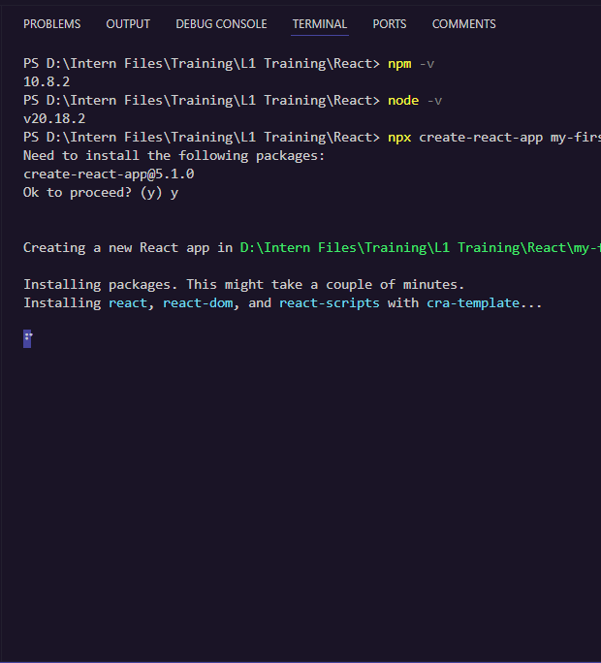
FAQs of React
How to use React in Visual Studio Code?
Using React in Visual Studio Code (VS Code) is straightforward and involves several steps, from setting up your development environment to running and editing your React applications. Here’s a concise guide on how to do this:
1. Need Node.js , npm and Visual Studio.
2. Set Up a New React Project:
npx create-react-app my-app.
3. Navigate to the Project Directory.
4. Install Extensions (Optional).
5 .Develop your Application.
6 .Start the Development Server.

Slide 28
FAQs of React Part II

Slide 29
FAQs of React
What is useEffect in React?
Definition: useEffect is a built-in Hook in React that allows you to perform side effects in function components. It acts similarly to lifecycle methods in class components (e.g., componentDidMount, componentDidUpdate, componentWillUnmount).
Key Features:
Managing Side Effects: Use it for data fetching, subscriptions, or manually changing the DOM.
Dependency Array: The second argument allows you to control when the effect runs.
Empty array ([]): Runs only on initial render.
Array with dependencies: Effect runs whenever the dependencies change.
Common Use Cases:
Fetching data from APIs.
Setting up event listeners.
Cleaning up resources (e.g., timers, subscriptions) on component unmount.

Slide 30
FAQs of React
What triggers useEffect?
The useEffect hook in React runs effects based on specified dependencies. Understanding what triggers useEffect is crucial for managing side effects in functional components.
Initial Render:
useEffect runs after the initial render of the component.
Dependency Array:
By providing a dependency array as the second argument, you can control when useEffect runs:
Empty Array []: Runs only once after the initial render (componentDidMount).
Non-Empty Array: Runs after the initial render and whenever any value in the dependency array changes (componentDidUpdate).
No Dependency Array:
If no dependency array is provided, useEffect will run after every render (both initial and subsequent updates).
Handling Cleanup:
If specified, the cleanup function inside useEffect runs before the component unmounts or before the effect runs again, ensuring resources are released.

Slide 31
FAQs of React
What does useEffect return in React?
Understanding the Return Value:
The useEffect hook itself does not return a value that you use directly. Instead, it can optionally return a cleanup function.
Cleanup Function:
If your effect performs side effects that require cleanup, you can return a function from your effect:
This cleanup function runs before the component unmounts and before the effect runs again.
Use cases include cleaning up subscriptions, timers, or event listeners.

Slide 32
FAQs of React
What does useEffect return in React?
useEffect is a Hook in React that allows you to perform side effects in functional components. It is called after the component renders.
Cleanup Function:
useEffect can return a cleanup function. This function is executed when:
The component unmounts.
Before the effect runs again on subsequent renders.
No Return Value:
If no return value is specified, useEffect simply schedules the effect without cleanup.

Slide 33
FAQs of React
Why does useEffect run twice in React?
Strict Mode in Development:
In development mode, React's Strict Mode intentionally invokes effects twice (i.e., runs cleanup functions and re-renders) to help identify side effects.
This behavior helps ensure that effects are idempotent and can handle unexpected scenarios.
Initial Render and Dependency Updates:
On the initial render, useEffect runs after the first render completes.
If there are dependencies specified in the dependency array, the effect will re-run whenever those dependencies change.
Common Misunderstanding:
Many developers mistake the double invocation in Strict Mode as an issue, rather than a feature aimed at promoting better code practices.

Slide 34
FAQs of React
How many times is useEffect called?
Invocation Frequency:
useEffect is called after every render of the component in which it is used.
Impact of Dependencies:
If an empty dependency array [] is provided, useEffect will only run once after the initial render.
If the dependency array contains variables (e.g., [value]), it will run after the initial render and every time any of the dependencies change.

Slide 35
FAQs of React
How many times is useEffect called?
The useEffect function runs after the paint (render) of the component.
This means it runs asynchronously after the DOM has been updated.
Behavior Explained:
In a typical React lifecycle:
Initial Render: Component renders first, displaying the UI.
useEffect Invocation: After rendering, React executes the code inside useEffect.

Slide 36
FAQs of React
Why should we not use useEffect in React?
Complexity in Component Lifecycle:
useEffect can lead to confusion regarding component lifecycle management, especially for newcomers.
Misunderstandings in dependency arrays can result in unintended re-renders or side effects.
Performance Issues:
Heavy use of useEffect can degrade performance due to unnecessary render cycles.
Every state change triggers execution of effects, potentially leading to performance bottlenecks.
Cluttered Code:
Overusing useEffect can make components difficult to read and maintain.
It can lead to nested dependencies and convoluted logic that complicate debugging.
State Synchronization Problems:
Asynchronous updates can cause stale state issues, leading to unpredictable behavior.
Dependency mismatches can cause effects to run at unexpected times.

Slide 37
FAQs of React
Why is useEffect called inside a component?
Side Effects Management:
useEffect is designed to handle side effects like data fetching, subscriptions, or manually changing the DOM within functional components.
Component Lifecycle Simulation:
It simulates the component lifecycle methods (componentDidMount, componentDidUpdate, and componentWillUnmount) allowing for the execution of side effects at particular stages of a component's lifecycle.
Dependency Tracking:
The second argument of useEffect (the dependency array) allows developers to specify when the effect should re-run, thereby optimizing performance and controlling re-renders.
Clean-up Logic:
The ability to return a cleanup function allows for resource management, preventing memory leaks by cleaning up after components unmount or before re-running effects.

Slide 38
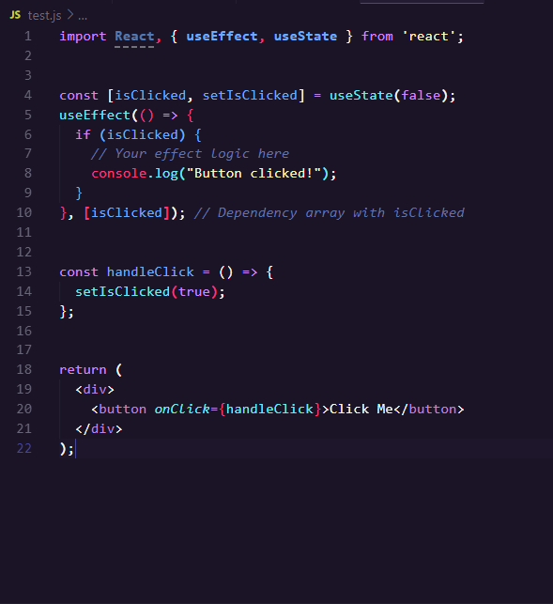
FAQs of React
How do I run useEffect on click?
To run a useEffect hook based on user clicks, you can manage state that tracks whether a click event has occurred. Here's how you can achieve this:
Import Hooks: Ensure you import useEffect and useState from React.
Create State: Initialize a state variable that will be updated on click.
Set up useEffect: Use the useEffect hook to perform actions based on the isClicked state.
Handle Click Event: Create an event handler that updates the state when the button is clicked.
Render Component: Render a button or any element that triggers the click event.

Slide 39
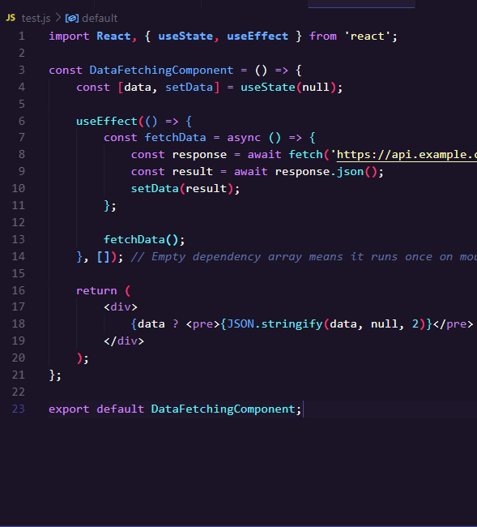
FAQs of React
How do you useEffect inside a function?
useEffect is crucial for managing side effects in functional components, offering a powerful tool for enhancing the functionality of your React applications.
Declare useEffect: Call it at the top of the functional component to schedule effects.
Define Effect Logic: Inside the callback function, specify what the effect should do (e.g., fetch data).
Add Dependencies: Provide an array that dictates when the effect runs (e.g., on mount, specific state changes).
Basic Points:
Place useEffect directly inside your React functional component.
It can be used multiple times for different effects.
The cleanup function is essential for managing resources.

Slide 40
FAQs of React
Why is state management important in React applications?
Data Consistency:
Keeps UI and data in sync. Changes in the state reflect immediately in the UI, ensuring a seamless user experience.
Predictable State Changes:
Centralizes state management allows for predictable updates, making it easier to track changes and bugs.
Component Communication:
Facilitates communication between components without prop drilling, allowing for better structure and maintainability.
Performance Optimization:
Prevents unnecessary re-renders by managing what parts of the UI need to update based on state changes.
Enhanced Developer Experience:
Tools like Redux DevTools enhance debugging capabilities, making it easier to trace state changes over time.
Scalability:
Simplifies the management of complex state, allowing applications to scale without the state becoming unmanageable.

Slide 41
FAQs of React
Why is state management important in React applications?
Introduction to Hooks:
Introduced in React 16.8 to address common issues faced in functional and class components. Provides a more powerful and flexible way to manage state and side effects in components.
Key Reasons for Introducing Hooks:
State Management in Functional Components.
Simplified Code Reuse.
Easier to Understand.
Side Effects Management.
Improving the Development Process:
Encourages Functional Components.
Better Readability and Maintenance.
Performance Optimization.
Community and Ecosystem.

Slide 42
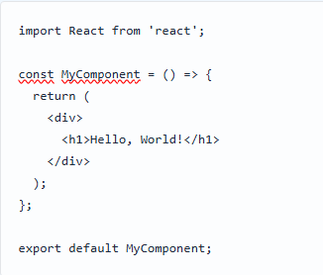
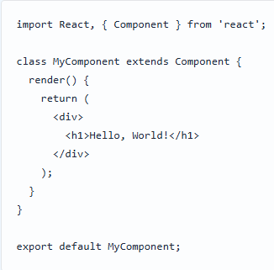
FAQs of React
How to create Component in React?
1. Understanding Components:
Components are the building blocks of a React application.
They allow for reusable UI elements that manage their own state.
2. Types of Components:
Functional Components: Simple functions returning JSX. Ideal for presenting UI.
Class Components: ES6 classes that extend React.Component. Can hold and manage their own state.

Slide 43
FAQs of React
How to create Function Component?
Functional Components: Simple functions returning JSX. Ideal for presenting UI.
Define the Function Component
Create a function that returns JSX. The function name should begin with an uppercase letter.
Export the Component
Export the component to make it available for use in other files.
Use the Component
Import and use the component in another file.

Slide 44
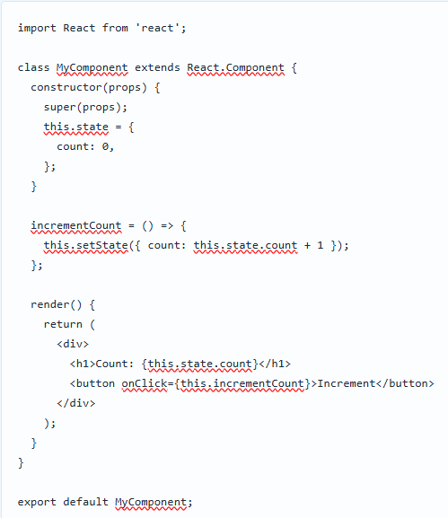
FAQs of React
How to create Class Component in React?
Class Components: ES6 classes that extend React.Component. Can hold and manage their own state.
Class components allow powerful state management and lifecycle control in React applications.
They provide a structured way to create interactive UI components.
Basic Structure:
Import React: Ensure to import React library.
Create a Class: Define a class that extends React.Component.
Render Method: Implement the render() method to return JSX.

Slide 45
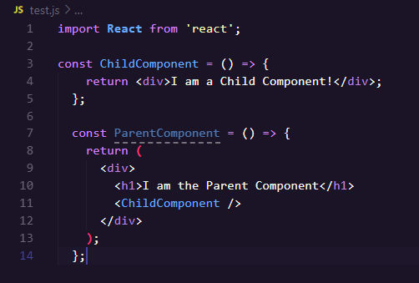
FAQs of React
How to Implement React Components within Components?
Creating Nested Components:
Define components in separate files or within the same file.
Importing Components:
Import nested components at the beginning of the parent file.
Rendering Child Components:
Use the nested component as a JSX tag within the parent’s render method or return statement.
By nesting components, you can build complex UIs effortlessly while maintaining organized and reusable code structures in React.

Slide 46
FAQs of React
How to handle ReactJS - Events?
Binding Event Handlers:
Bind event handlers in the constructor (class components) or use arrow functions to maintain the correct context (this).
Using Functional Components:
With functional components, you can define the event handler as a regular function or use hooks (e.g., useState, useEffect).
Preventing Default Behavior:
Use event.preventDefault() to prevent the default action associated with an event.
Passing Parameters to Event Handlers:
You can pass parameters to your event handler by wrapping it in an arrow function.
Handling Multiple Events:
You can attach multiple events to the same component based on specific actions or states.

Slide 47
FAQs of React
How Do You Use the useState Hook?
Importing: Import useState from React at the top of your component file.
Initialization: Call useState with the initial state as an argument to declare a state variable.
State Variable: The first element of the array returned by useState is the current state value.
State Setter: The second element of the array is a function to update the state.
Updating State: Use the state setter function to change the state, triggering a re-render of the component.
Batched Updates: React batches state updates for performance optimization.
Lazy Initialization: You can pass a function to initialize state based on a computation, only executed on the first render.
Functional Updates: Use a function as an argument to the setter for updating state based on the previous state.
Multiple States: You can use multiple useState calls in a single component to manage different pieces of state independently.

Slide 48
FAQs of React
How to Use the useState() Hook in a Form in React?
Import useState: Ensure you import the useState hook from React at the beginning of your component.
Initialize State: Use useState(initialValue) to create state variables for form inputs, where initialValue can be an empty string or predefined values.
Bind State to Inputs: Set the value attribute of each input field to its corresponding state variable to make them controlled components.
Handle Changes: Create a change handler function that updates the state using the setter function from useState when the input value changes.
Submission Handling: Implement a function to handle form submission, which prevents default behavior and utilizes the state values as needed.

Slide 49
FAQs of React
How to Use the useState() Hook in a React Counter App?
Initialize State: Call useState() to declare a state variable (e.g., count) and a function to update it (e.g., setCount).
Set Initial Value: Pass the initial state value (e.g., 0) to useState().
Update State: Use the updater function (e.g., setCount) to modify the state. This can be triggered by event handlers, such as button clicks.
Render State: Display the state's current value (e.g., count) in the component's return statement.
Handle Increment/Decrement: Create functions to increment or decrement the state value by invoking setCount with the new value.
Re-render on State Change: Understand that changes to the state triggers a re-render of the component, displaying the updated count.
Functional Updates: For complex state updates, consider using a functional version of the state setter to ensure accurate calculations based on previous state.

Slide 50
FAQs of React
What Can You Store in State?
User information
UI state (e.g., visibility of components)
Form data (e.g., input values)
Application settings
Temporary data (e.g., loading status)
Data fetched from APIs
Component-specific information
Session information
Flags for conditional rendering
History or navigation state
Caching data for performance
Interaction states (e.g., selected items)
User preferences and configurations
Animation states and transitions

Slide 51
FAQs of React
How Do You Update State?
Understand state management principles
Identify the current state to be updated
Determine the source of the new state information
Use appropriate methods or functions to initiate state update
Ensure immutability of state (if applicable)
Trigger re-rendering of components if needed
Handle asynchronous updates and side effects
Validate new state to avoid data inconsistencies
Test updates to ensure functionality and performance
Document state changes for clarity and maintainability

Slide 52
Nisanth Saravanan

